Slide 1

Kosova Travel Guide: A Project Overview
Welcome! We're excited to introduce Kosova Travel Guide, an innovative online platform that aims to revolutionize travel experiences in Kosovo. This presentation outlines our vision, key features, and development strategy for this project.
By: Adhurim Canhasi
Arjeta Llapashtica
Vjollca Ademi

Slide 2
The Need for a Dedicated Kosovo Travel Guide
A Gap in the Market
Boosting Tourism & Exploration
Despite Kosovo's growing tourism potential, a comprehensive and interactive travel guide solely dedicated to the country is absent. Existing platforms often mention Kosovo briefly as part of broader guides, lacking the specific information tourists seek.
Kosova Travel Guide will empower visitors to discover hidden gems, plan their trips effectively, and experience Kosovo's rich culture and diverse landscapes to the fullest.

Slide 3
Key Features: A User-Centric Approach
1
City & Region Selection
2
Step-by-Step Trip Planner
Tailored recommendations and itineraries based on user preferences, ensuring a personalized travel experience.
A game-like progress bar guides users through each stage of their trip, making planning fun and interactive.
3
Flight & Airport Information
Access to real-time flight details, arrival instructions, and airport services, facilitating smooth travel.

Slide 4
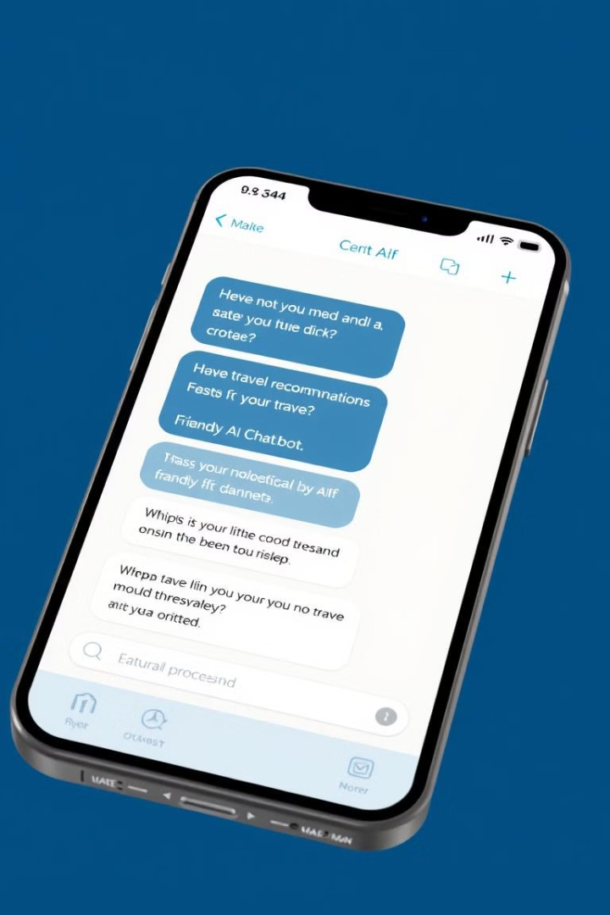
Beyond the Basics: Enhancing the Tourist Experience
Taxi & Transport Suggestions
Reliable and trustworthy transportation options for navigating the country, ensuring a seamless travel experience.
Hotel & Accommodation Listings
A comprehensive database of accommodations, catering to various budgets and travel styles, with user reviews and ratings.
Restaurant & Food Recommendations
Discover authentic Kosovar cuisine and explore diverse culinary options, filtered by location and cuisine type.
Top Tourist Attractions
A curated list of must-visit places, highlighting Kosovo's rich history, culture, and natural beauty.

Slide 5




Interactive & Informative: Going Beyond the Ordinary
Interactive Map
Cultural Insights & Fun Facts
AI Chatbot Guide
Visualize routes, attractions, local services, and points of interest, enhancing the travel experience.
Learn about Kosovo's history, traditions, and culture through engaging content, enriching the travel experience.
Instant travel assistance, providing answers to frequently asked questions, recommendations, and local information.

Slide 6

Building the Platform: Leveraging Modern Technologies
1
Frontend
Next.js (React Framework) for a dynamic and user-friendly interface, coupled with Tailwind CSS for modern and responsive styling.
2
Backend
Node.js with Express.js for efficient server-side logic and data handling, ensuring a smooth user experience.
3
Database
Firebase Firestore for real-time data storage, enabling dynamic content updates and personalized recommendations.

Slide 7




Seamless Integration: Connecting with Essential Services
Google Maps API
For mapping, directions, and location-based services, enhancing the website's usability and navigation features.
OpenAI API
Powering the AI chatbot for natural language processing, providing intelligent and interactive travel assistance.
Travel APIs
Integrating flight, hotel, and other travel services for real-time information, booking, and price comparison.

Slide 8
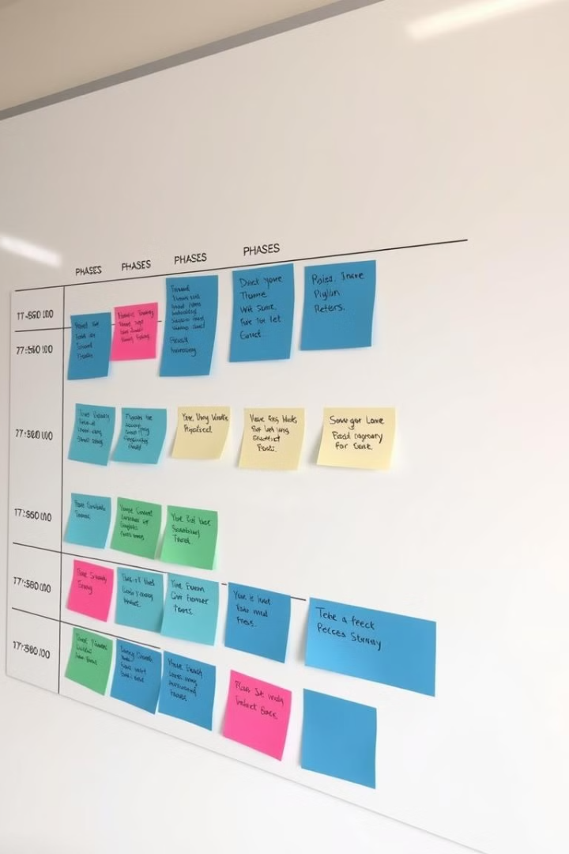
Project Timeline: Delivering a High-Quality Product
Phase 1: Planning & Research (Week 1-2)
1
Defining website features, designing user interface, and gathering essential travel data, laying the foundation for the project.
Phase 2: Development - Core Features (Week 3-7)
2
Building the core functionalities, including city selection, trip planner, and travel recommendations, establishing the website's foundation.
Phase 3: Enhancements & UI Improvements (Week 8-9)
3
Adding user authentication, enhancing design, and optimizing performance, refining the website's user experience.

Slide 9


Final Steps: Ensuring a Successful Launch
Testing & Bug Fixing (Week 10-11)
Deployment & Finalization (Week 12-13)
1
Thorough testing of all features, fixing issues, and optimizing performance, ensuring a smooth and reliable user experience.
Deploying the website on Vercel, final quality checks, and documentation, preparing for launch and marketing.
2

Slide 10
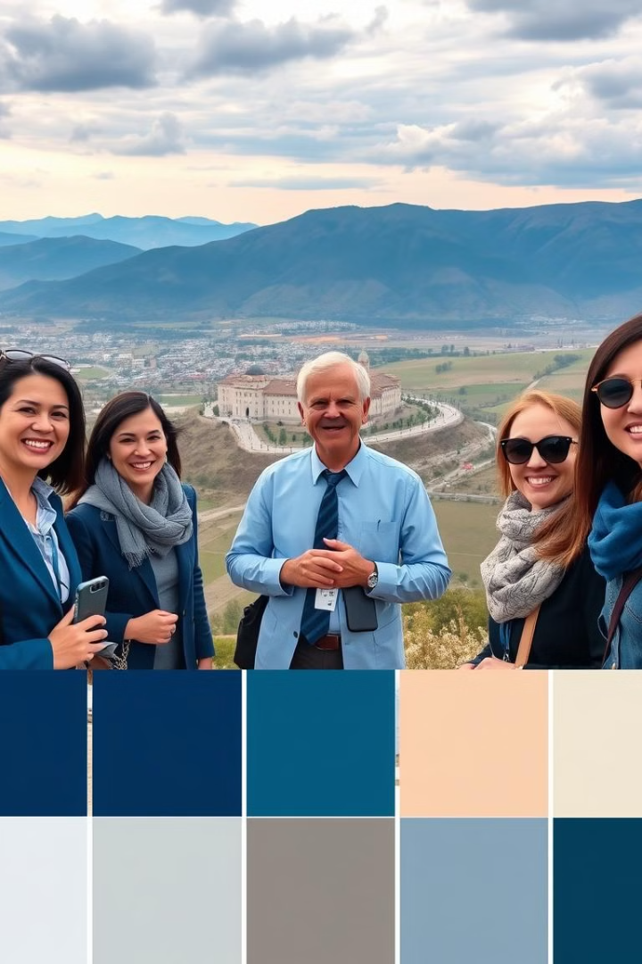
The Future of Kosova Travel Guide: A Vision for Growth
Kosova Travel Guide has the potential to become a vital tool for promoting Kosovo's tourism, attracting visitors worldwide, and driving economic growth. We believe this project will not only enhance travel experiences but also showcase our expertise in web development and our commitment to supporting the tourism industry in Kosovo.

